Slide 1
Agenda
Figma — Design Evaluation and Evolution
LLM Research
Weekly Retrospective

Slide 2
Figma Design Evolution: User Evaluation

Slide 3
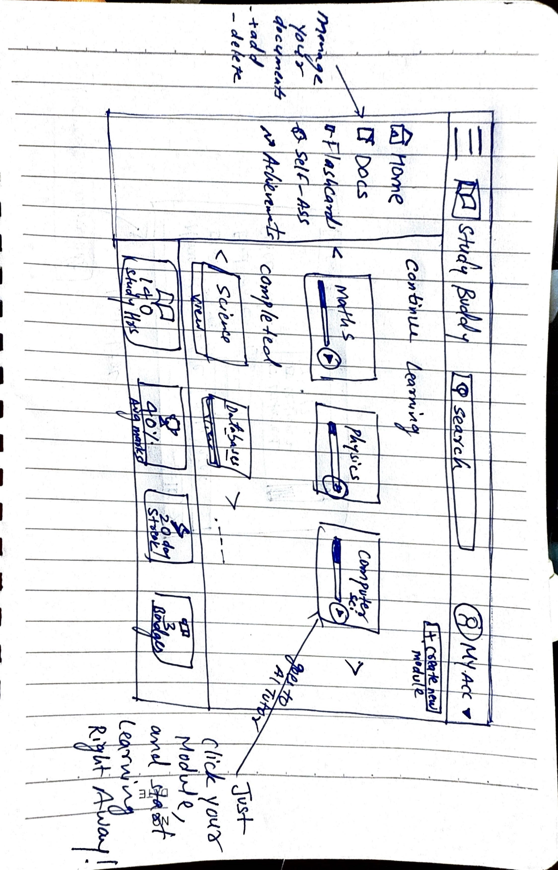

Slide 4
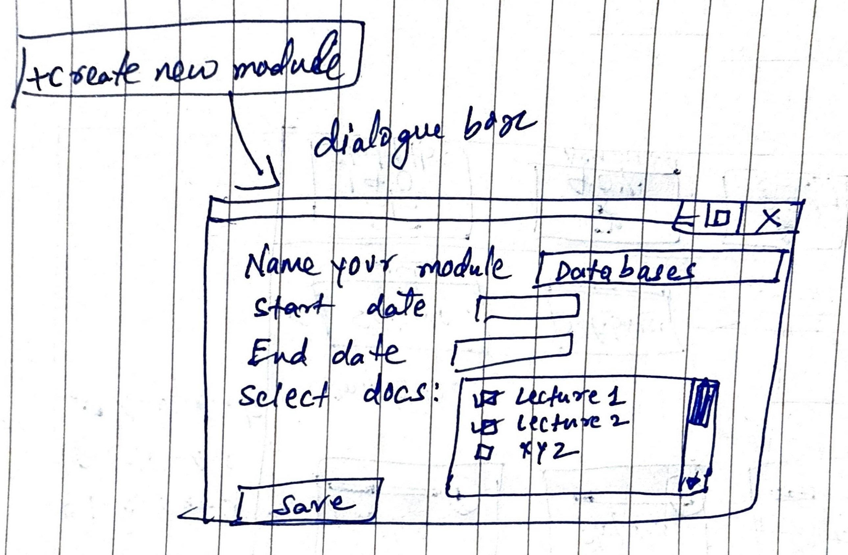

Slide 5
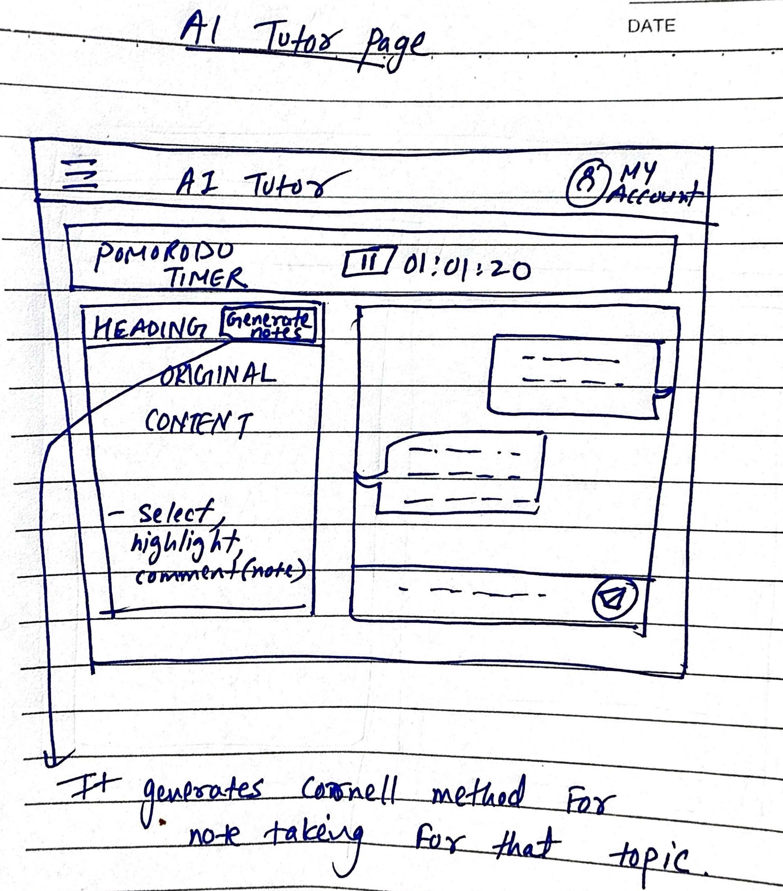

Slide 6
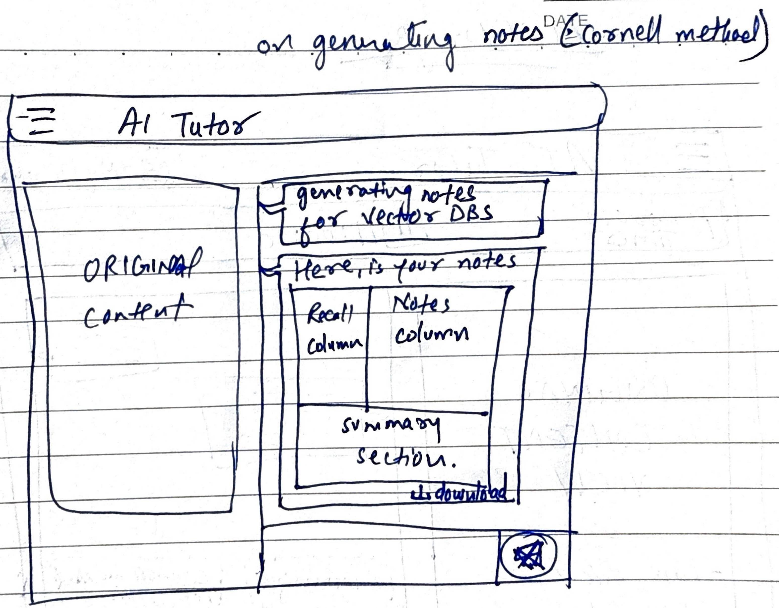

Slide 7
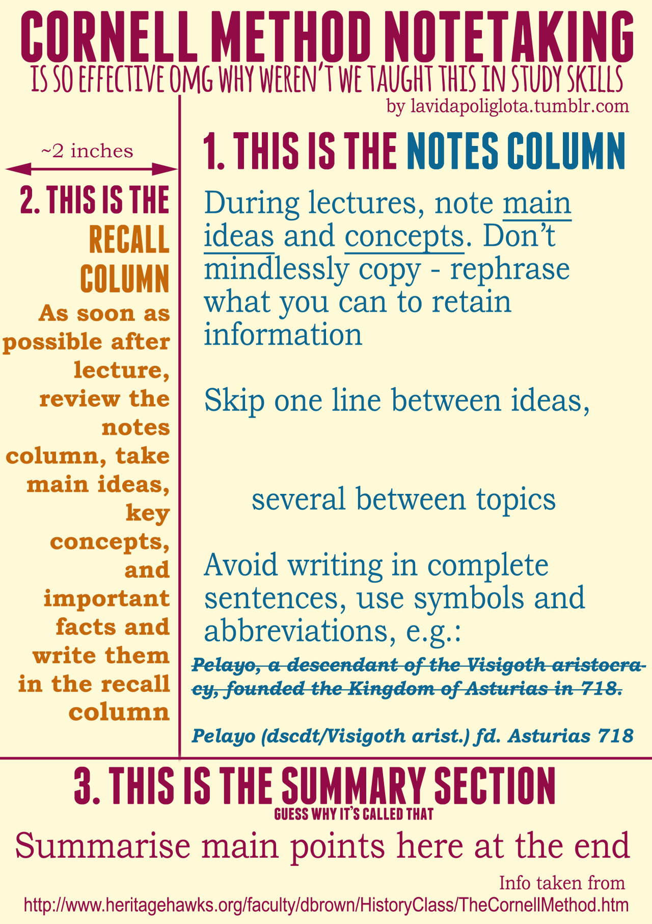
Study Method — Cornell Note‑Taking

Slide 8
LLM Research — Study Assistance

Slide 9
What the Study Assistant Must Do
Explain
Explain clearly with step‑by‑step reasoning and cite sources (Cognitivism).
Adapt
Adapt to the learner’s pace and provide feedback/rewards (Behaviorism).
Support
Support collaboration and building on prior knowledge (Constructivism).
Handle
Handle long context from PDFs/notes and answer grounded to retrieved chunks (RAG).
Run
Run affordably; predictable token spend; low latency for Q&A.

Slide 10
Evaluation Criteria
Answer quality: factuality, depth, step‑by‑step clarity, references.
Context handling: long inputs, retrieval grounding, refusal behavior.
Latency & stability: time‑to‑first‑token, streaming, rate limits.
Cost control: tokens per answer, summarization efficiency.
Safety & privacy: handling of sensitive student data.
Ecosystem: tool calling, RAG libraries, SDK maturity.

Slide 11
Quick Comparison (Qualitative)
Model | Reasoning | Long Context | Cost (relative) | Ecosystem | Tone for Tutoring
Claude (Anthropic) | Excellent | Excellent | $$ | Good | Warm, explanatory
GPT (OpenAI) | Excellent | Very good | $$$ | Excellent | Concise & tool‑friendly
Gemini (Google) | Good | Excellent | $/Free tier | Good | Detailed; sometimes verbose
Grok (xAI) | Variable/Improving | Good | $ | Growing | Direct; check citations
Open‑source (Llama etc.) | Good with tuning | Varies | $ (infra) | DIY | Customizable

Slide 12
Integration with Our Architecture
Store
Store files in Postgres (metadata) + OneDrive/S3 (blobs); parse & chunk; store embeddings in pgVector.
RAG
RAG pipeline: Retrieve top‑k chunks → cite sources → generate step‑wise explanation.
Use
Use function/tool calling for calculators, unit conversion, quiz generation.
Token
Token controls: max tokens, answer templates, compression & caching.

Slide 13
OpenAI GPT-5 — Overview for Study Assistance
Flagship model family with an optional 'thinking' mode for complex questions.
Strong at step‑by‑step explanations, tool use, and document‑grounded RAG Q&A.
Tiers: mini (fast/economical), standard (balanced), pro (max reasoning).
Works well with our stack: retrieval first → cite sources → generate explanation.
Good single‑vendor baseline while we benchmark Claude/Gemini/Grok and OSS.

Slide 14
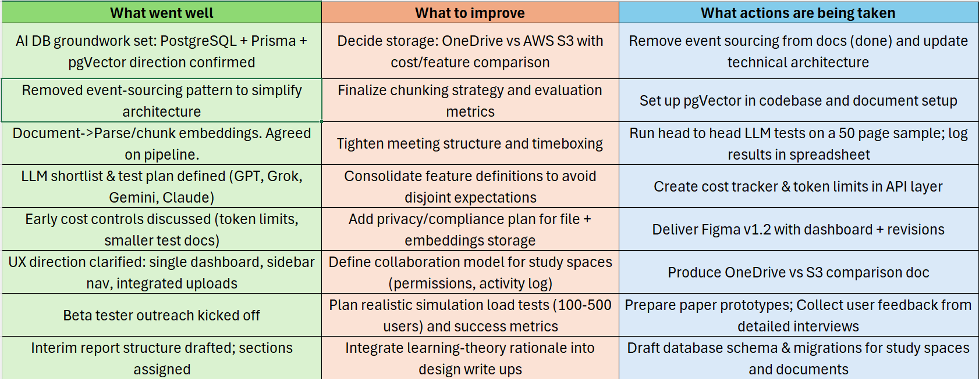
Retrospective — This Week

Slide 15
Next Steps
Set up pgVector + RAG skeleton; log retrieval context with answers.
1
Run head‑to‑head tests on the 50‑page sample; export to comparison spreadsheet.
2
Decide OneDrive vs S3 for storage; document cost and developer ergonomics.
3
Finalize chunking strategy (≈1k tokens) and evaluation templates.
4

